Slide 1

COVID-19 VACCINATION
GUIDED BY:
MR. S. THIVAHARAN
ASSISTANT PROFESSOR,
CSE
PSGiTech
MINI PROJECT
FIRST YEAR CSE
SUBMITTED BY:
SRI HARI M
PRANAV KIRAN S
RATHAN ASWATH S,
JISNU S,
VIBHAV KRISHNAN K S

Slide 2
PROBLEM STATEMENT
To develop a routine to input the patient details along with medical issues(if any) and check for the vaccine availability in that particular state where patient resides only in INDIA and decide the dosage of vaccine for the patient based on their age and also to allot date for the first and second vaccination based on the patient’s availability.
Patient details include Name, Age, Gender, State, Phone number, Patient Type(if any).
This one is very useful in the current pandemic time to store data for the patients who gets vaccinated.

Slide 3
SCOPE
CONTROL STRUCTURES
LOOPING CONSTRUCTS
CSV FILE HANDLING

Slide 4
PROPOSED METHODOLOGY
COVID 19 VACCINATION
Patient details
Data base
Medical issue
Vaccine availability
Dosage
Date allotment

Slide 5
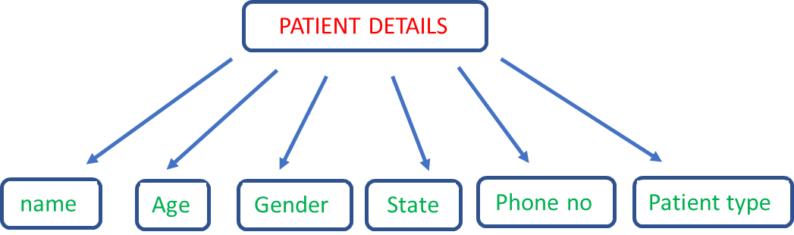
PROPOSED METHODOLOGY
DATABASE
Six Parameters
Stored in List
CSV Module
Append Mode “a”
MS Excel

Slide 6
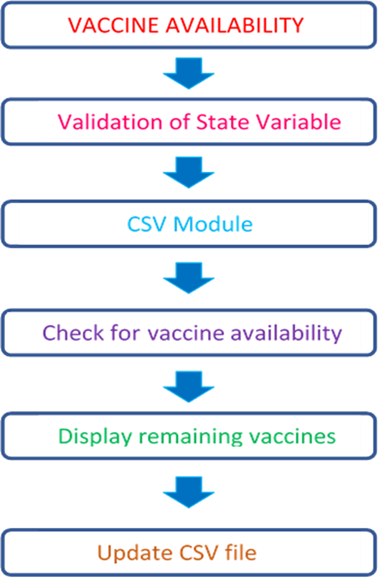
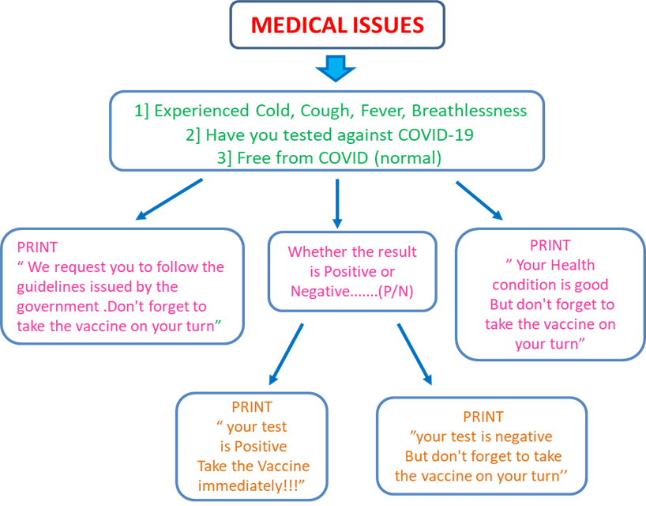
PROPOSED METHODOLOGY

Slide 7
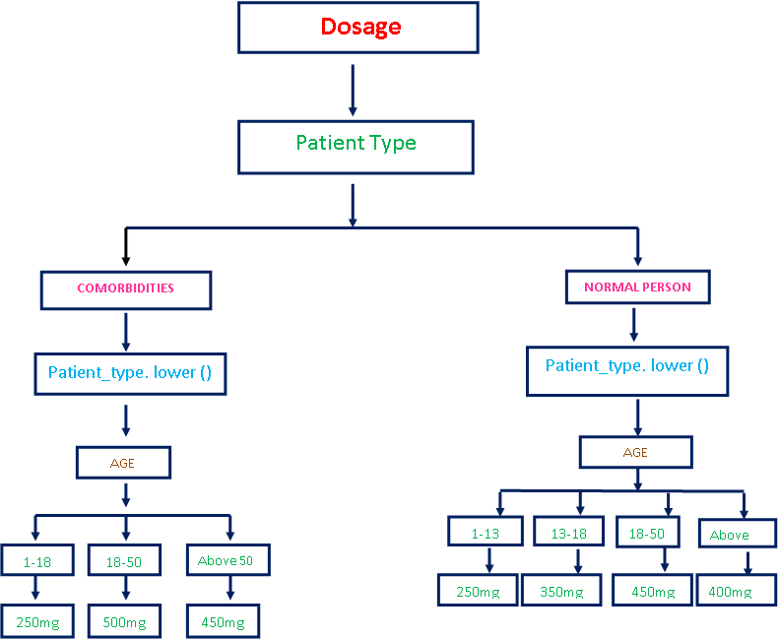
PROPOSED METHODOLOGY

Slide 8
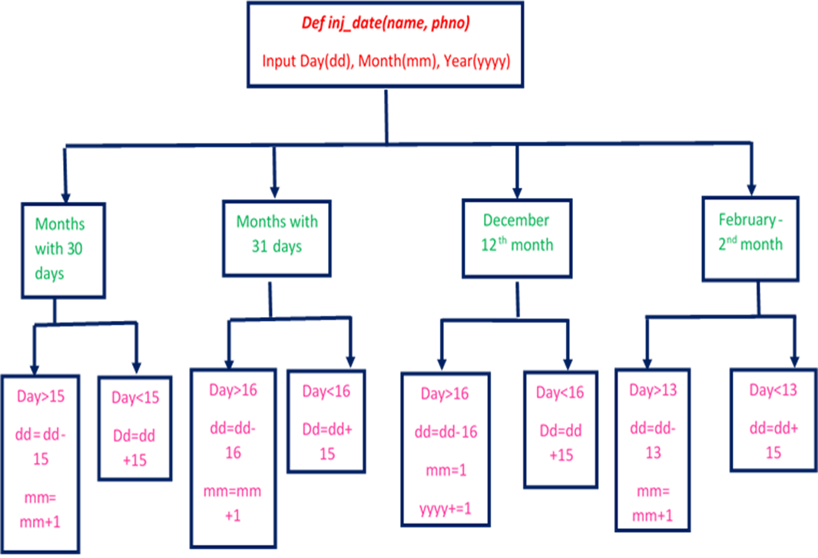
PROPOSED METHODOLOGY

Slide 9

ALGORITHM
Patient Details : -
The Display function gets six parameters from the main function
Name
Age
Gender
State
Phone number
Patient type
This function is called to display the patient details in a table format.
Print keyword is used to display the details.
Center () is a built-in function in string data type. Syntax of center () function is center (width, fillchar).
It returns a string with the original string centered to a total of width columns and filled with fillchar in columns that do not have characters.
Example for center () function: -
>>> str1 = “ Python”
>>> print (str1.center(10,” = ”))
==Python==

Slide 10
ALGORITHM
MS Excel Database : -
The Database function is called to store the records in the MS Excel Database. It gets six parameters namely Name, Age, Gender, State, Phone number, Patient type.
The values of the parameters are stored in list using Extend () built-in function.
Extend () is used to add multiple elements to the list in the same time.
Using CSV module, the elements in the list is stored in the MS Excel.
CSV file is a human readable text file where each line has a no of fields, separated by commas or some other delimiters.
CSV files have an extension of ".csv".
Here ‘a’ mode used to append the records in the MS Excel database.

Slide 11
ALGORITHM
Medical Issue : -
First of all created a time delay function to Create a animation slide
An if-elif-else condition is used to check whether the person
1)Experienced Cold, Cough, Fever, Breathlessness
2)Have you tested against COVID-19
3)Free from COVID (normal)
Under the elif condition, we used nested if-else condition to check whether the patient is positive or negative Eg.) Have you tested against COVID-19
If we enter 2
Whether the result is Positive or Negative.......(P/N)
If we enter P
PRINT“ your test is Positive Take the Vaccine immediately!!!”
If we enter N
PRINT ”your test is negative But don't forget to take the vaccine on your turn”

Slide 12
ALGORITHM
Vaccine Availability : -
The incoming string variable for place may be in upper or lower case and may also have blank spaces in it. So in order to have a standard state name , all characters are turned to uppercase and without any blank spaces in it.
For Example : Tamil Nadu → TAMILNADU
A csv file with various state name and corresponding vaccine availability is already created .
The already created csv file is opened in read mode to read the availability of vaccines.
The entire content in that file is read and converted to a list data type.
Since every row in csv file is separated by an empty row, the empty lists present in the content list is removed.
The content list is iterated throughout its content and following steps are performed :
If the given state is available with vaccines, "Vaccine Available" is printed and number of vaccines in that state is reduced by 1 in the content list variable.
Else, "Vaccine not available" is printed.
Then the same csv file is opened in write mode to update the content.

Slide 13
ALGORITHM
Age Wise Dosage : -
This function definiton gets two parameters as input from the main funtion-
Age
PatientType :- Whether the patient is normal or has some Comorbidities:-Whether He/She is suffering from Diabetics,Heartattack,Bp,etc
Explicit conversion of the variable age is done for condition checking
An if-else condition is checked whether the person has Comorbidities or not because Separate dosage should be given for people those who are suffering from the condition
True condition(if part) of the for loop checks for the patient who are suffering from Comorbidities
False condition(else part) of the for loop check for normal patients
Inside the if condition lower function (.lower())is used to minimize the errors if so the person gives mixed character
(Example :- ComOrbiDities)
then while checking the condition string comparison is Case sensitive and it can cause errors.
Inside the if condition and else condition Nested if-else concept is used which check for the age category of the patient and it prints the entered age and required dosage for the particular patient.

Slide 14
ALGORITHM
Date Allotment : -
Define a function dateofvac() with name of the patients and phone number(phno) as parameters
Initialise 3 variables (dd, mm, yyyy) to obtain the date(dd), month(mm), year(yyyy) of the 1st Vaccination sitting date from the programmer.
The date entered is printed collectively and further processed with several conditions.
The months are categorised as months with 30 days, months with 31 days. February has a separate condition as it has 28 days and the following conditions are checked using “IF-ELIF” statement
Further, there is a separate condition for the dates before and after 15 days in the case of months with 30 days and 16 days before and after 16 days in the case of 31 days.
For the 12th month December, when the date obtained is before 15th, then the date is added by 15. Whereas when the date is after 15th of the same month, the date is subtracted by 15 and year(yyyy) is added by 1.
Similarly, for the 2nd month February, when the date obtained is before 13th, then the date is added by 15 and if the date is after 13th then the date is subtracted by 13 and the month(mm) is added by one.
Once when these conditions are checked, the 2nd Vaccination sitting date is sent to the respective patients phone number

Slide 15
TEAM’S WORK SPLIT UP
STUDENT’S NAME | WORK SPLIT UP
1) SRI HARI M | Patient Details MS Excel Database
2)PRANAV KIRAN S | Date Allotment
3)RATHAN ASWATH S | Medical Issue
4) JISNU S | State Vaccine Availability
5)VIBHAV KRISHNAN K S | Validation for inputs Age Wise Dosage

Slide 16
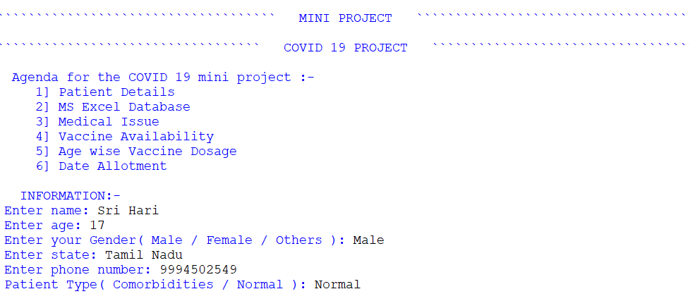
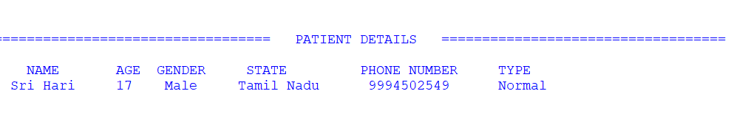
SCREENSHOTS ( OUTPUT)

Slide 17
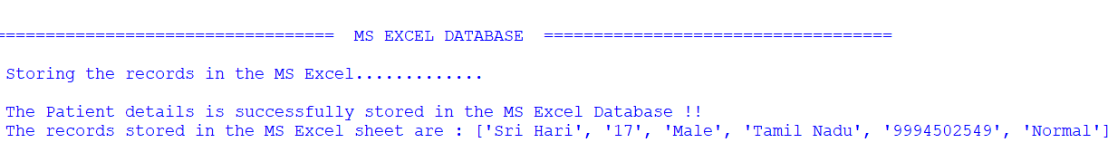
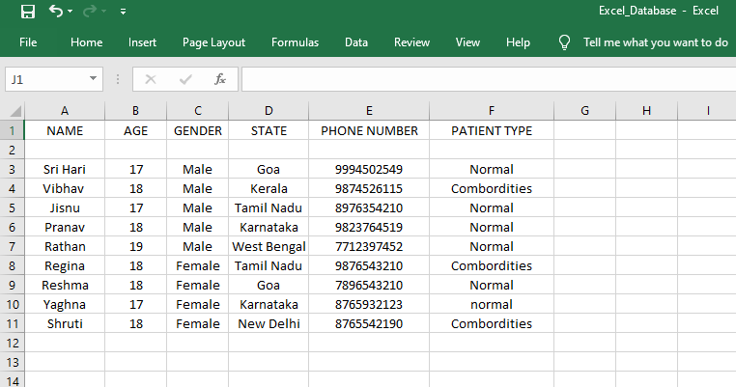
SCREENSHOTS ( OUTPUT)

Slide 18
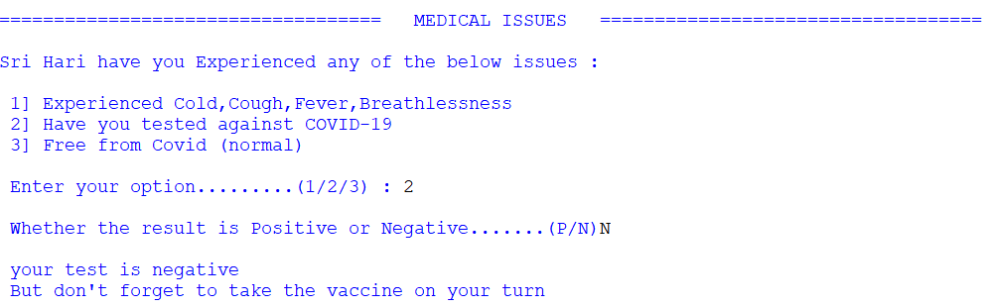
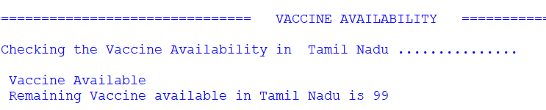
SCREENSHOTS ( OUTPUT)

Slide 19
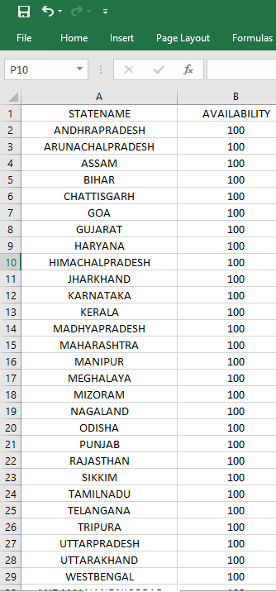
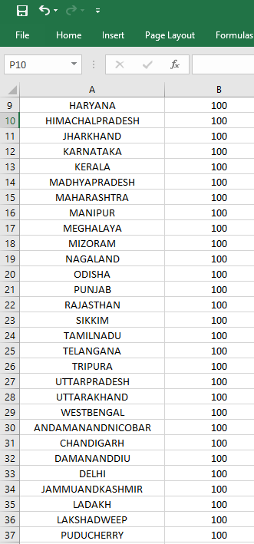
SCREENSHOTS ( OUTPUT)

Slide 20
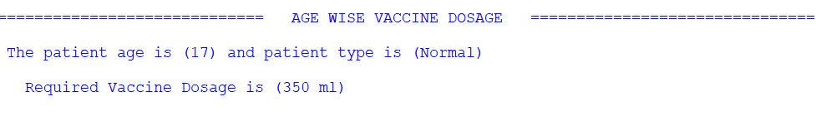
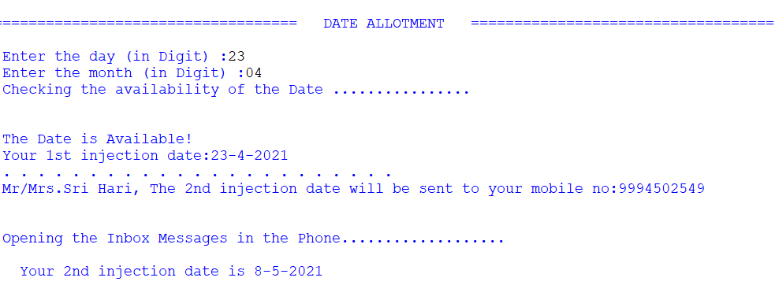
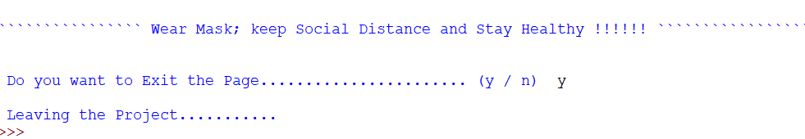
SCREENSHOTS ( OUTPUT)

Slide 21
CONCLUSION
This program is to check for the vaccine availability and decide the dosage of vaccine and allotment of date for vaccination executed properly for valid inputs.
Further this program can be considered as a model and developed with additional features (mentioned in future work) to make it feasible and usable for the COVID-19 vaccination.

Slide 22
FUTURE WORKS
Addition of Aadhar verification as a basic criteria to identify the user’s nationality .
The person can be checked whether he/she is already vaccinated or not based on their Aadhar number.
Based on the feasibility, availability of vaccines in each district of each state can be made available.
Further, a restriction like each day at a particular state only a particular number of vaccinations may be done and date for vaccination can be allotted based on this.
Further a menu to select state, age, date and medical issues can be developed in order for the ease of the user.
Colorful and more interactive front end with pop ups can be developed to enrich the user experience.

Slide 23
REFERENCE
geeksforgeeks.org
programiz.com
realpython.com
Problem Solving And Python Programming [ Reema Thareja ]

Slide 24
THANK YOU !

